Slide 1
WELCOME, on behalf of
VEENBRINK | RVS
Quality is our priority

Slide 2
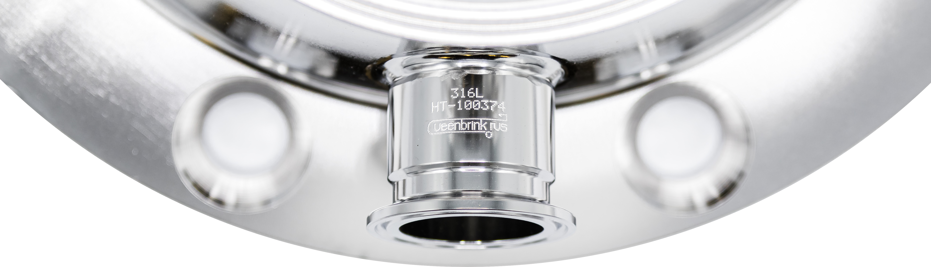
AGENDA
Introduction of Veenbrink RVS
What we do
Product range
Range of services
Mechanical, electrical & instrumentation and automation
How we do it
Who we work for
Quality is our priority
Success stories
01
02
03
04
Your ideal partner in the process industry
05
06
Veenbrink RVS serves its customers with high-quality process equipment. Quality, expertise and commitment have been our daily core values for more than 30 years.
07
08
09
Notes:
Introductie van Veenbrink RVS
Wat we doen
Productaanbod
Dienstenaanbod
Mechanica, elektra & instrumentatie en automatisering
Hoe we het doen
Voor wie wij er zijn
Kwaliteit is prioriteit
Succesverhalen
Samenwerking met Janssen Biologics
Lopende projecten
Aangevraagde projecten
Projecten die “on hold” staan

Slide 3
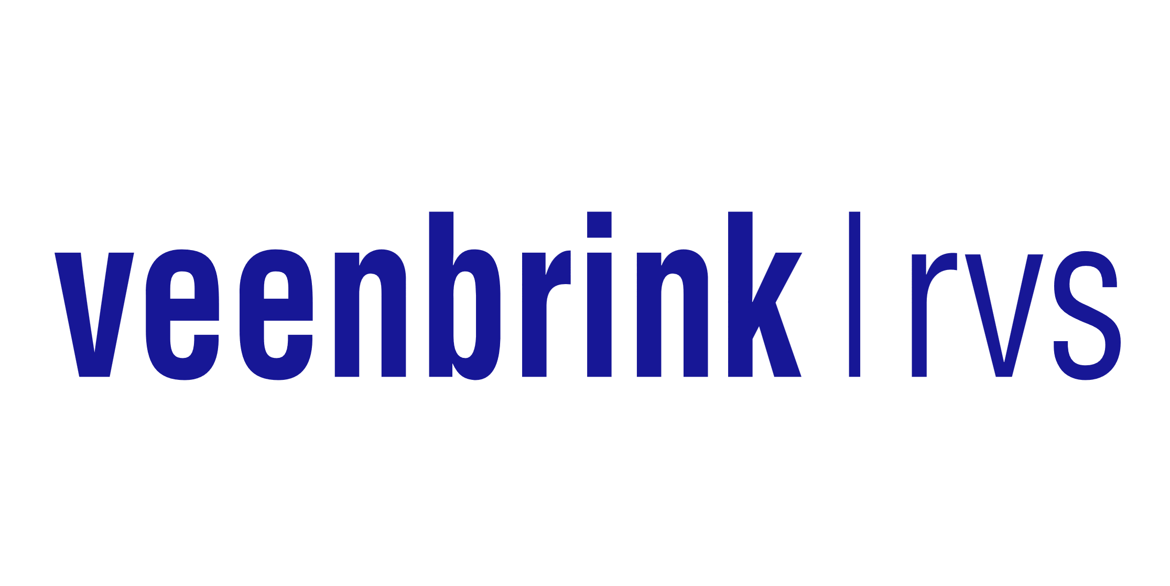
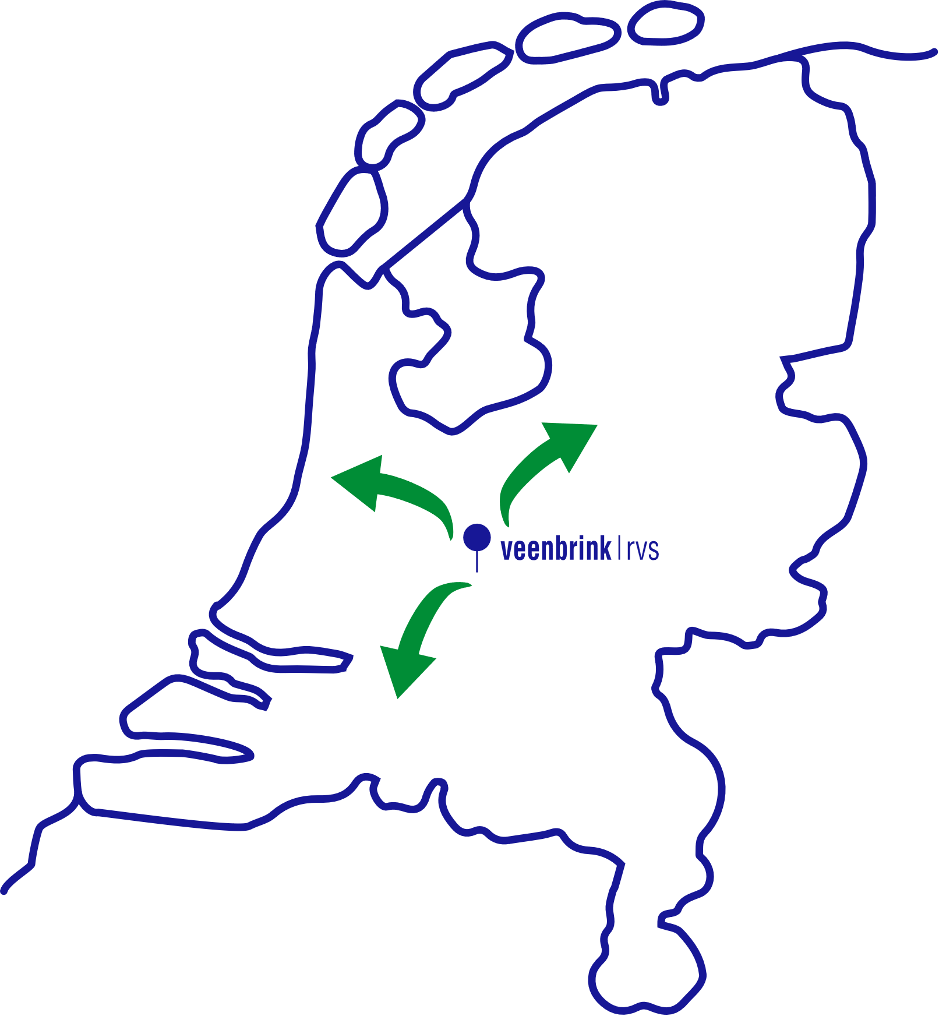
INTRODUCTION OF VEENBRINK RVS
FLEXIBLE
FAST
Tank and machinery manufacturer
High-quality process equipment
Small and medium-sized installations
Based in Montfoort, the Netherlands
30 employees
CRAFTSMAN-
SHIP
EXPERTISE
QUALITY
1991
FULL SERVICE
COMMITTED
Our
Core Values

Slide 4
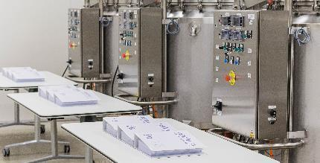
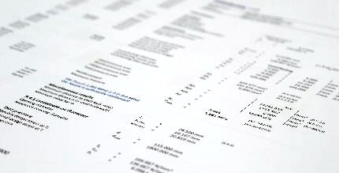
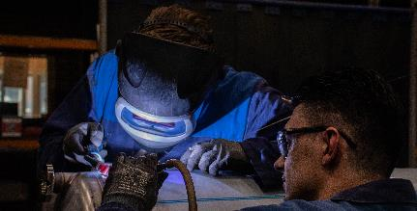
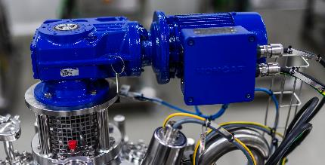
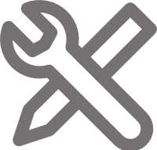
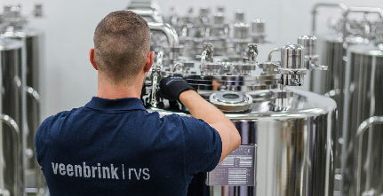
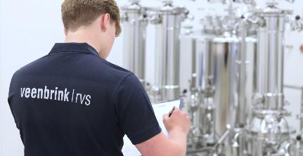
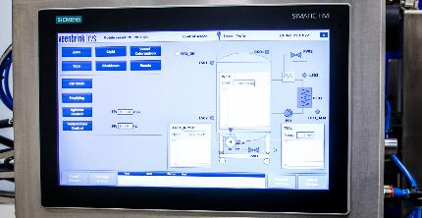
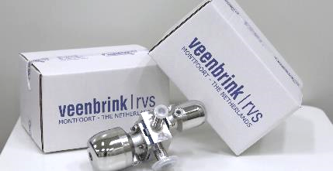
WHAT WE DO
Project management
Design engineering
Production
Modification and repair
Installation and (dis)assembly
Validating
Training
Service and maintenance
4

Slide 5
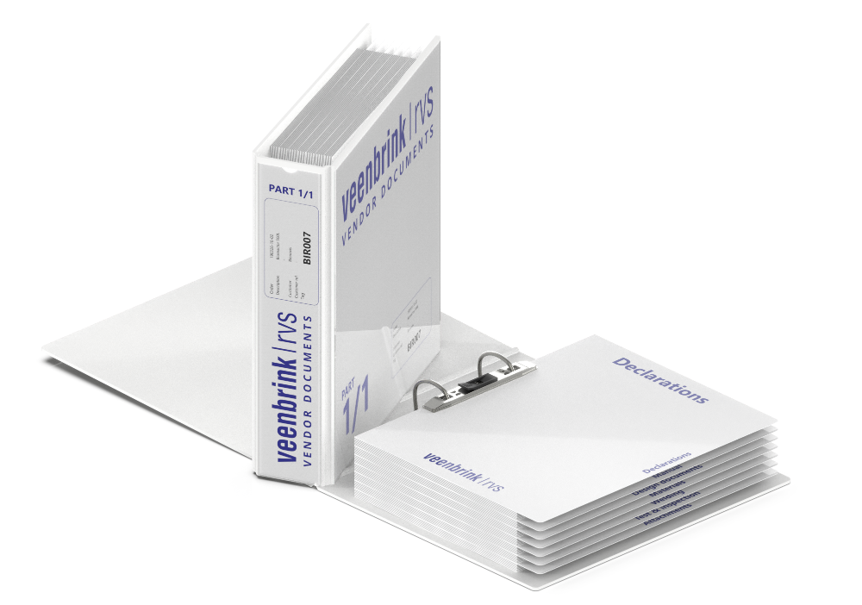
WHAT WE DO
PROJECT MANAGEMENT
Periodic meetings
Scope delineation
Planning management
Just-in-time organisation of people and resources
Quality management by QA coordinator
5

Slide 6
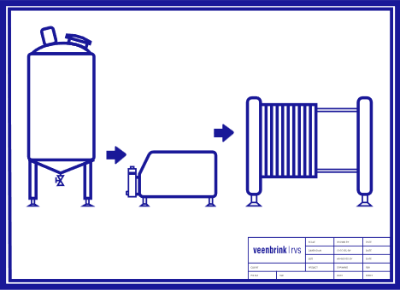
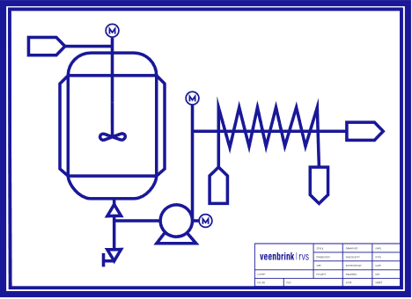
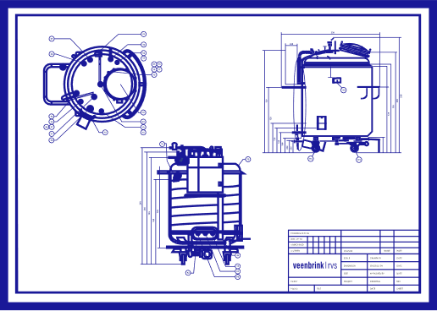
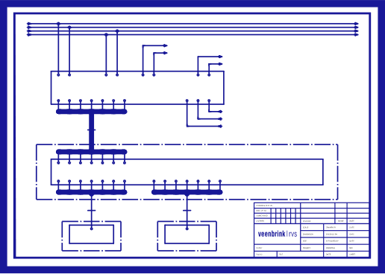
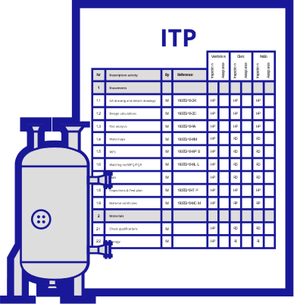
WHAT WE DO
Design & Construction
Testing & Validation
DESIGN ENGINEERING
VERIFICATION &
VALIDATION
PFD
HAZOP
P&ID
URS
PQ
Process Flow Diagram (PFD)
RTM
Piping & Instrumentation Diagram (P&ID)
FDS
OQ
Qualification
Mechanical
TDS
HDS
IQ
SDS
Electrical
Automation
DQ
Design
FAT SAT
Commissioning
Inspection & Test Plan (ITP)
Mechanical
Electrical
Automation
ITP
Production
6

Slide 7
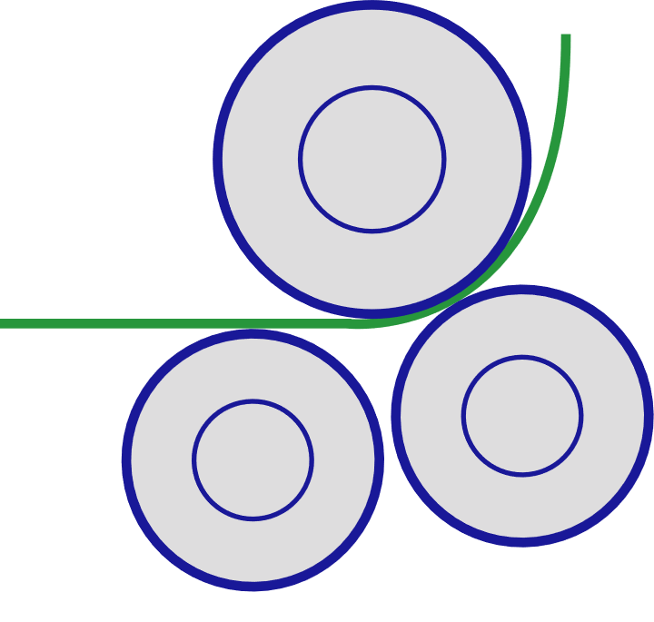
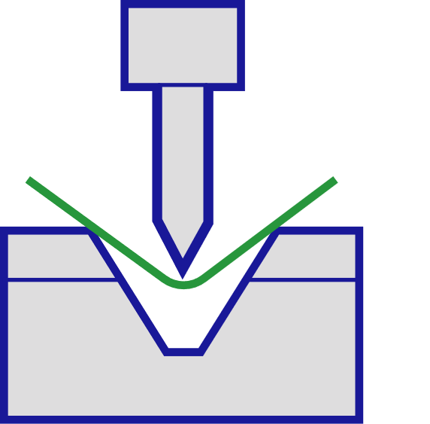
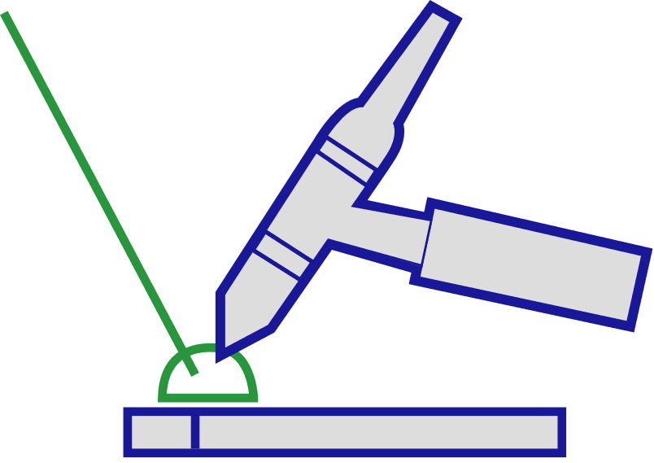
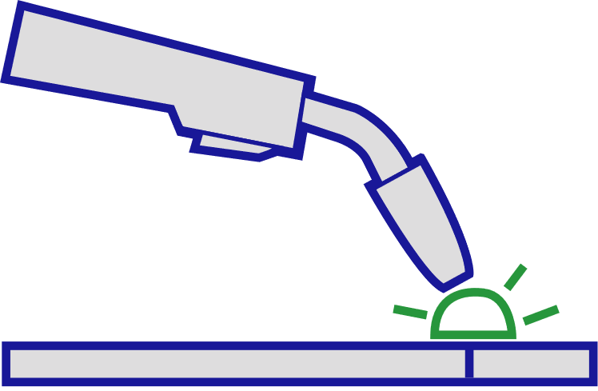
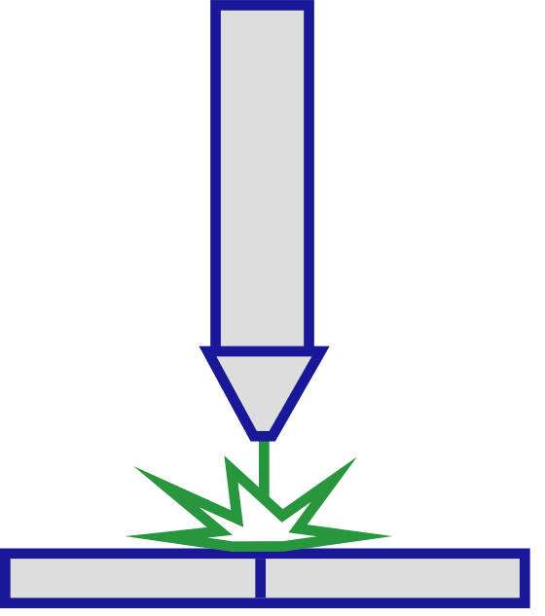
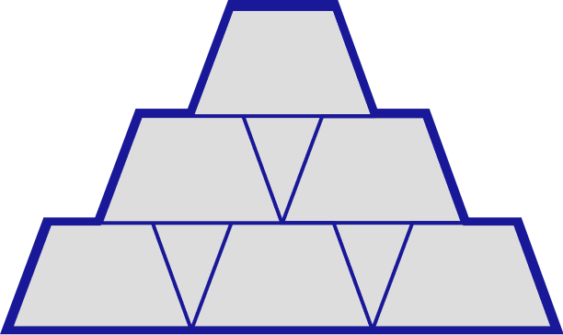
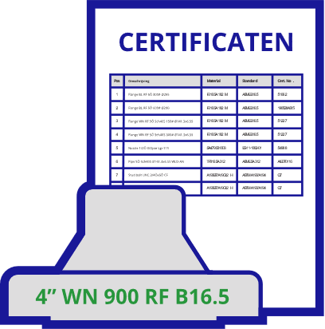
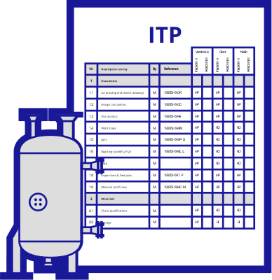
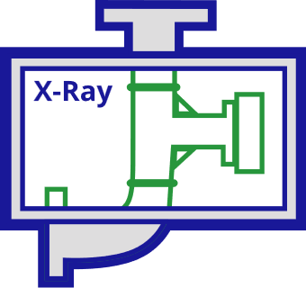
WHAT WE DO
Production begins with approved drawings and an inspection and test plan (ITP)
PRODUCTION
Deforming
Cutting, Rolling, Shearing, Boring, Tapping
Welding
TIG, MIG, Plasma, Orbital
Exotic alloys
Hastelloy, (super) Duplex, Nickel
UP TO 10 MM
UP TO L 4M
UP TO 20 MM
UP TO 20 MM
3 TO 12 MM
RMin. 50 MM
UP TO 170 TONNES
304(L)
316(L)
Finish
Grinding, Sanding, Polishing, Brushing, Blasting
Testing
ITP, NDT, Acceptance, Qualification
DUPLEX
HASTELLOY C276
NICKEL 200
SUPERDUPLEX
HASTELLOY C22
INCOLOY 800
UP TO 0.1 µm
7

Slide 8
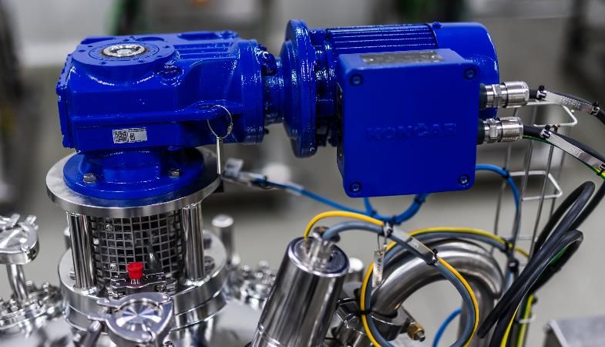
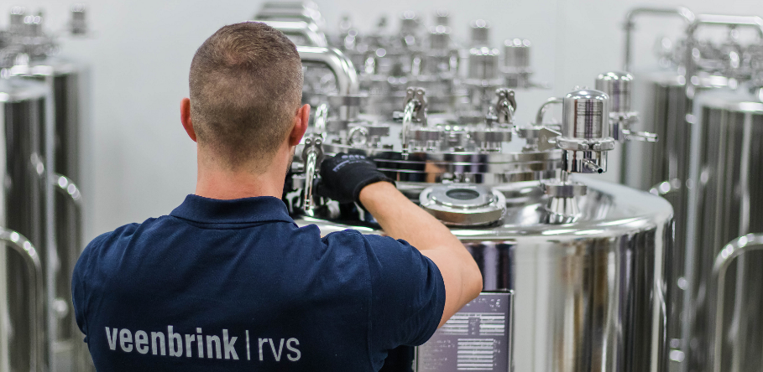
WHAT WE DO
MODIFICATION AND REPAIR
INSTALLATION & (DIS)ASSEMBLY
We modify and repair your equipment with minimal lead time to the highest degree of finish, in line with all applicable standards and guidelines.
Our experienced team is ready to install and (dis-)assemble your equipment: in our state-of-the-art FAT room or at your premises.
8

Slide 9
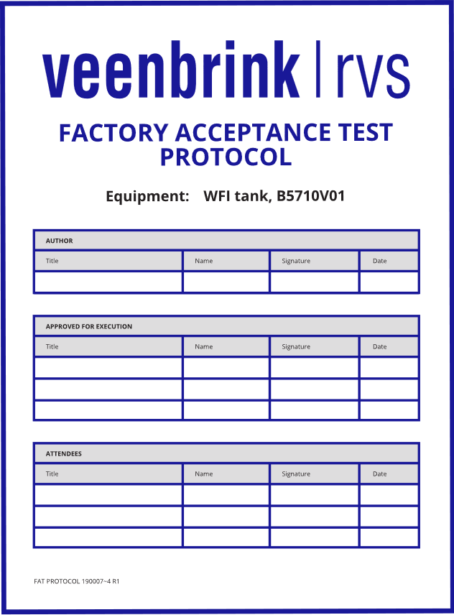
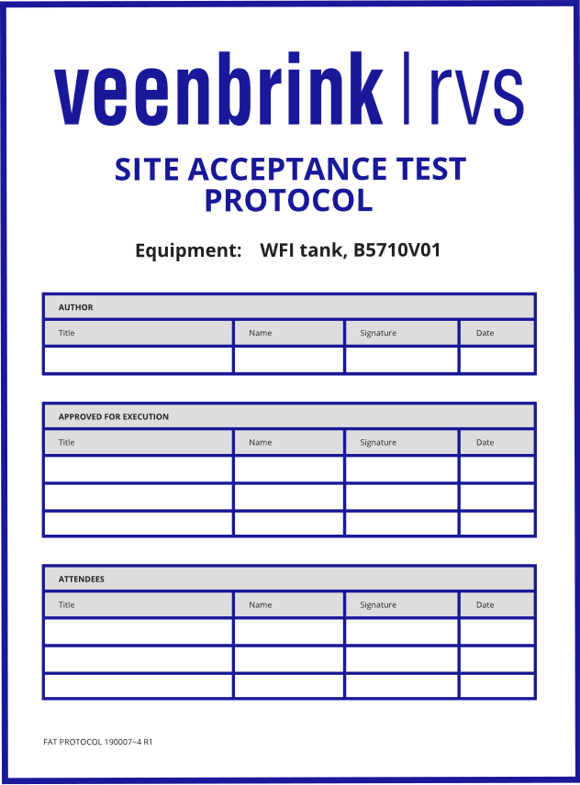
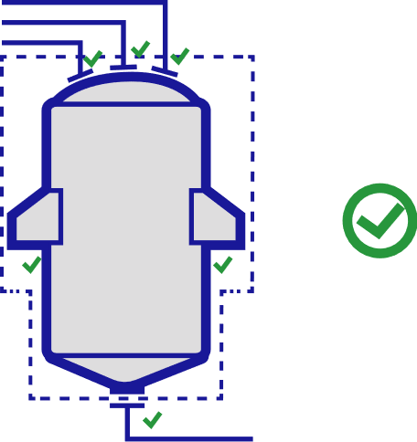
WHAT WE DO
Design & Construction
Testing & Validation
VALIDATING
VERIFICATION &
VALIDATION
PFD
HAZOP
P&ID
URS
PQ
Factory Acceptance Test (FAT)
RTM
Site Acceptance Test (SAT)
FDS
OQ
Qualification
Installation Qualification (IQ)
HDS
TDS
SDS
IQ
Operational Qualification (OQ)
DQ
Design
FAT
SAT
Commissioning
Performance Qualification (PQ)
Mechanical
Electrical
Automation
ITP
Production
9

Slide 10
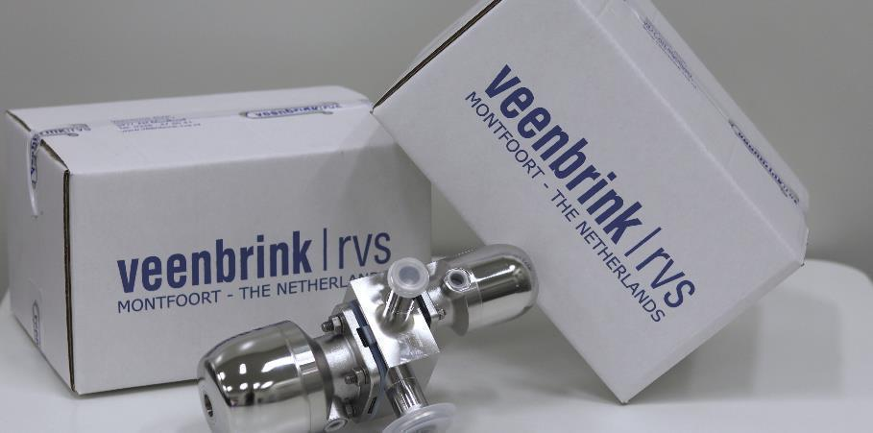
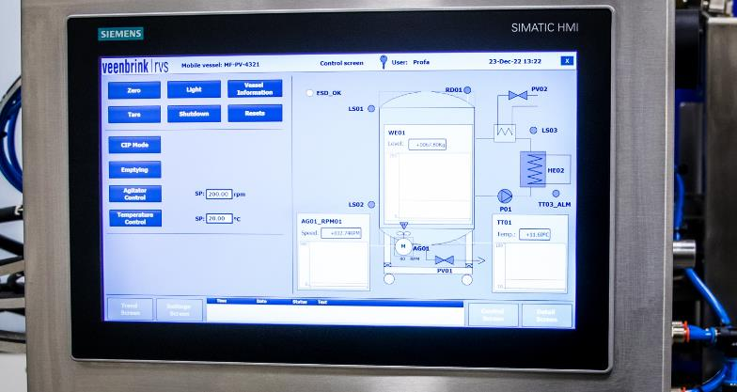
WHAT WE DO
TRAINING
SERVICE AND MAINTENANCE
In addition to regular installation and maintenance manuals, our training courses provide in-depth directions on how to use and maintain your process equipment.
We offer periodic maintenance services for your process equipment, through which our experienced team avoids or solves problems with your equipment and maximises its reliability and lifespan.
10

Slide 11
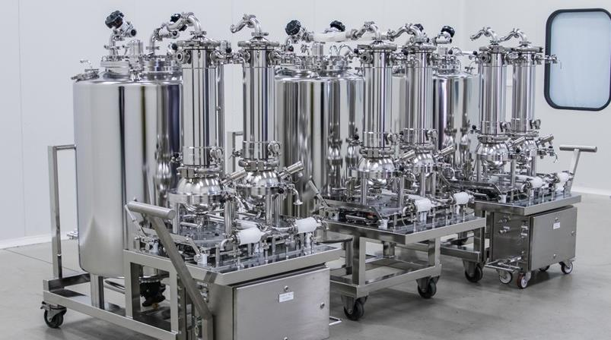
PRODUCT RANGE
PROCESS AND PREPARATION EQUIPMENT
PROCESS AND PREPARATION EQUIPMENT
Veenbrink RVS is a specialist tank and machine builder within the process industry. We supply a wide range of process equipment designed to produce and store a diverse range of media.
STORAGE AND BUFFER EQUIPMENT
SKID CONSTRUCTION
PLATFORMS
TRANSPORT AND TOOLS
PROCESS COMPONENTS
11

Slide 12
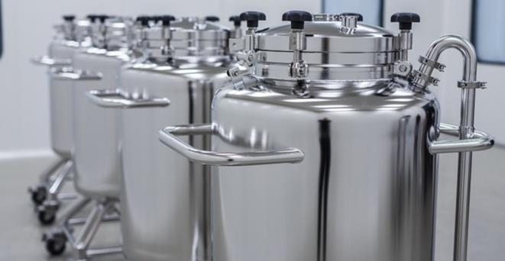
PRODUCT RANGE
PROCESS AND PREPARATION EQUIPMENT
STORAGE AND BUFFER EQUIPMENT
Veenbrink RVS designs and manufactures storage and buffer tanks, both single-walled and insulated and equipped with all necessary process connections in terms of safety, cleaning, homogenisation, sampling or access and inspection.
STORAGE AND BUFFER EQUIPMENT
SKID CONSTRUCTION
PLATFORMS
TRANSPORT AND TOOLS
PROCESS COMPONENTS
12

Slide 13
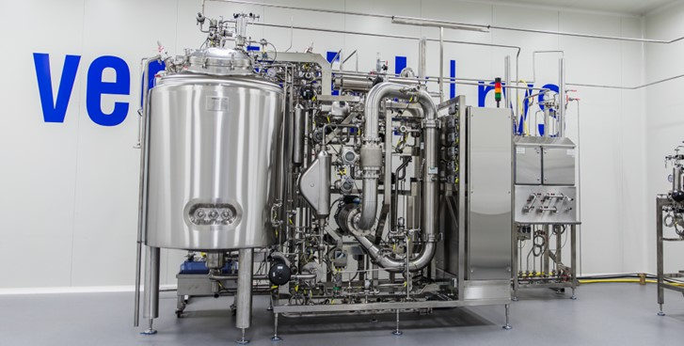
PRODUCT RANGE
PROCESS AND PREPARATION EQUIPMENT
SKID CONSTRUCTION
In addition to separate process equipment, Veenbrink RVS also designs and produces integrated total solutions in a complete skid, where tanks, valves, pumps, instrumentation, fittings and connecting piping are seamlessly connected and delivered plug-and-play.
STORAGE AND BUFFER EQUIPMENT
SKID CONSTRUCTION
PLATFORMS
TRANSPORT AND TOOLS
PROCESS COMPONENTS
13

Slide 14
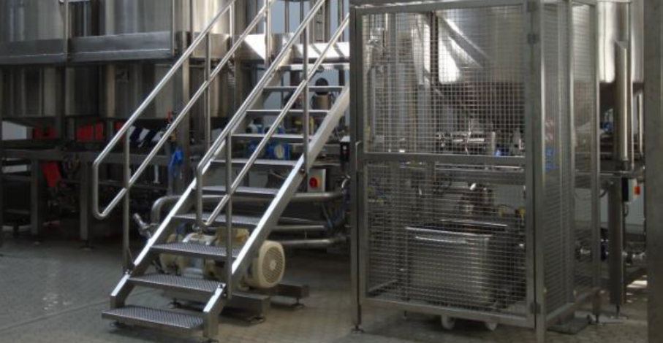
PRODUCT RANGE
PROCESS AND PREPARATION EQUIPMENT
PLATFORMS
Veenbrink RVS supplies customised platforms for safe and efficient access to various installations and spaces. Our platforms are designed and built to the highest standards of stability and safety, with attention to ergonomics and ease of use.
STORAGE AND BUFFER EQUIPMENT
SKID CONSTRUCTION
PLATFORMS
TRANSPORT AND TOOLS
PROCESS COMPONENTS
14

Slide 15
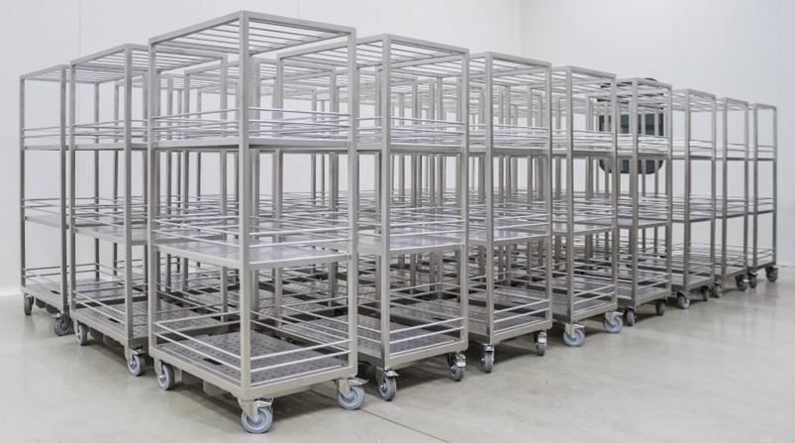
PRODUCT RANGE
PROCESS AND PREPARATION EQUIPMENT
TRANSPORT AND TOOLS
Our platforms are designed and built to the highest standards of stability and safety, with attention to ergonomics and ease of use.
STORAGE AND BUFFER EQUIPMENT
SKID CONSTRUCTION
PLATFORMS
TRANSPORT AND TOOLS
PROCESS COMPONENTS
15

Slide 16
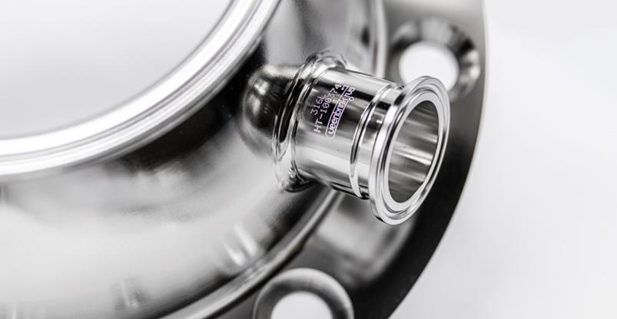
PRODUCT RANGE
PROCESS AND PREPARATION EQUIPMENT
PROCESS COMPONENTS
Veenbrink RVS offers high-quality customised process components for various applications, such as special reducers, hose tules, couplings, pipe fittings or tools.
STORAGE AND BUFFER EQUIPMENT
SKID CONSTRUCTION
PLATFORMS
TRANSPORT AND TOOLS
PROCESS COMPONENTS
16

Slide 17
RANGE OF SERVICES
Project management
Design engineering
Production
Modification and repair
Installation and (dis)assembly
Validating
Training
Service and maintenance
17

Slide 18
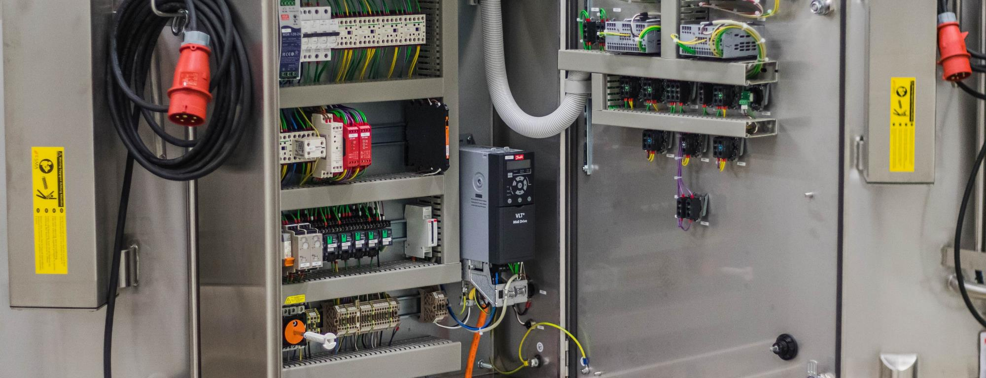
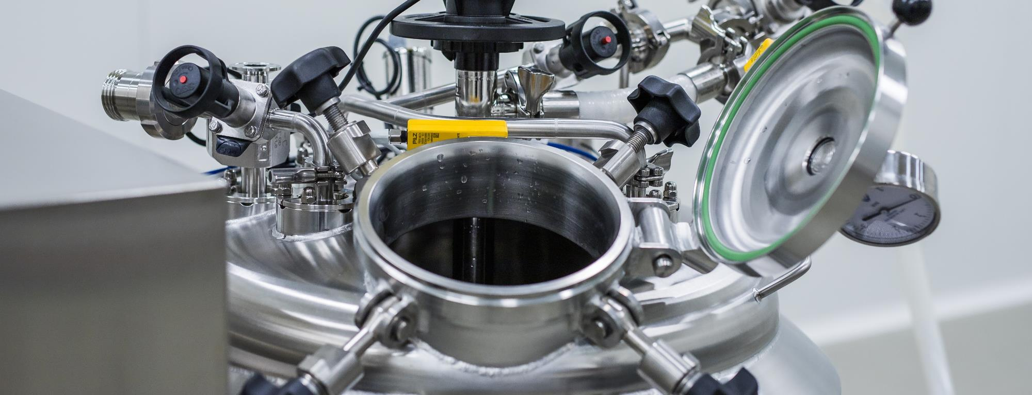
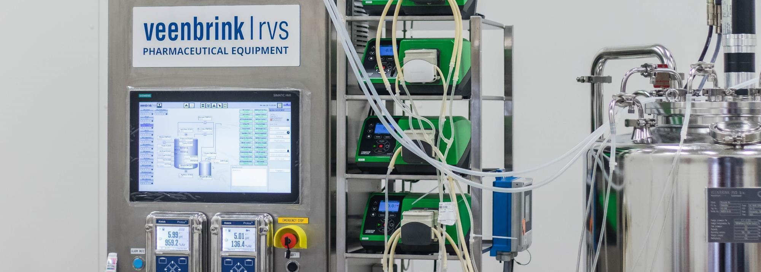
MECHANICAL, ELECTRICAL & INSTRUMENTATION AND AUTOMATION
Mechanical
Electrical & Instrumentation
Automation
We provide tailor-made mechanical solutions for complex issues, in the highest degree of finish and suitable for both atmospheric and pressurised applications. Veenbrink RVS supplies both single-walled and insulated tanks and equipped with all necessary process connections in terms of security, cleaning, sampling or access and inspection. In addition, facilities can be installed to stir, mix, heat or cool the medium. The right fittings and standards are applied depending on the specific application. We know better than anyone that every process is unique and therefore requires specific equipment requirements. We therefore design the equipment in close cooperation with you and the operators.
Veenbrink RVS does not stop at mechanics. We supply complete systems equipped with electrical components and the corresponding controls. With electronics and instrumentation, we can turn a relatively simple tank into a sophisticated machine. We supply machines for use in both safe and ATEX classified areas. Processes often require specific instrumentation for level, temperature, pressure and pH recording, among others. Do you have preferred suppliers for instrumentation? Great! Do you want us to select the best components? No problem!
The simplest solution for controlling your process equipment locally, is hardware-based and by means of push buttons on the electrical cabinet. For more options with controlling and monitoring programmes and recipes, you can opt for a PLC or, for larger systems, a SCADA solution, where control of your equipment can take place both locally and remotely. For automation, we work together with our renowned partners.
From A to Z (Turnkey)
Controls
Instrumentation
Heating and/or cooling jacket
Stirring technology
18

Slide 19
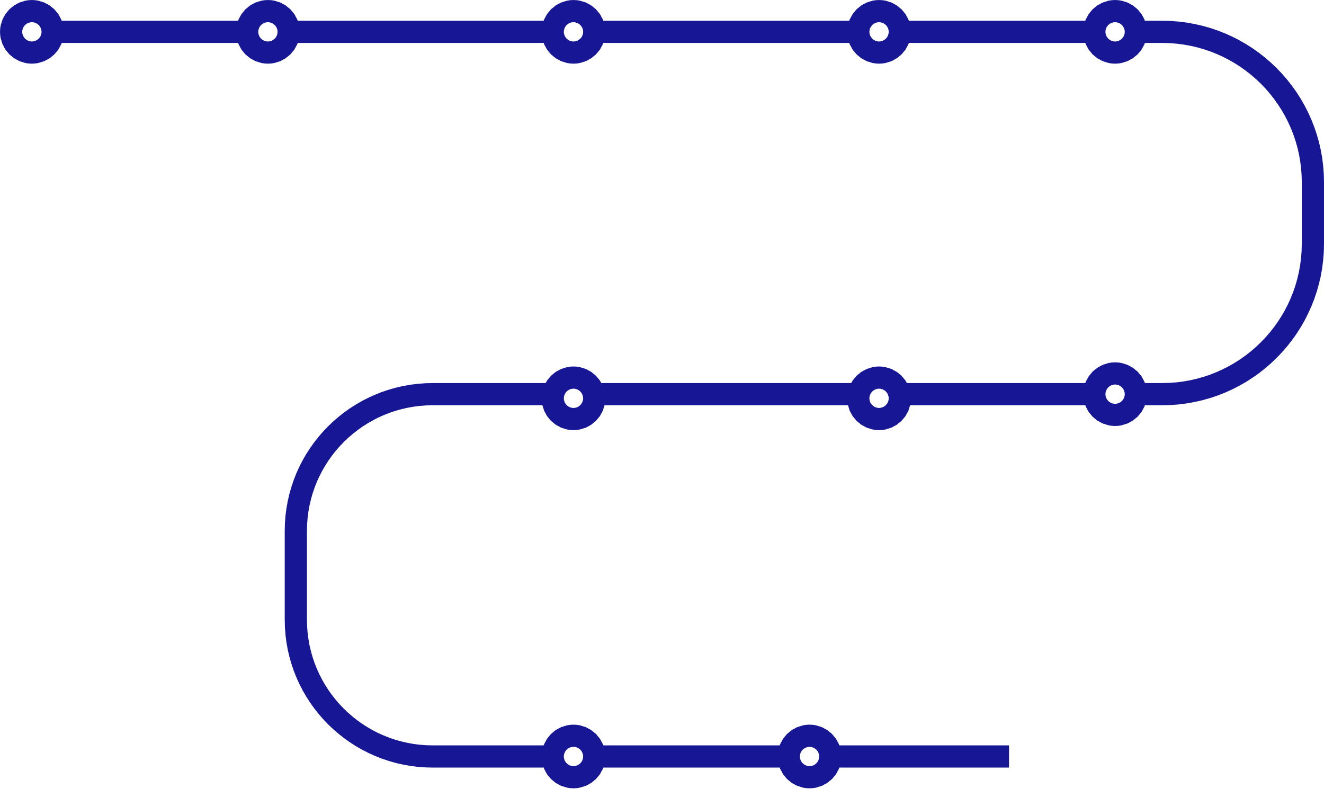
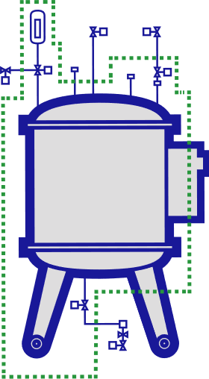
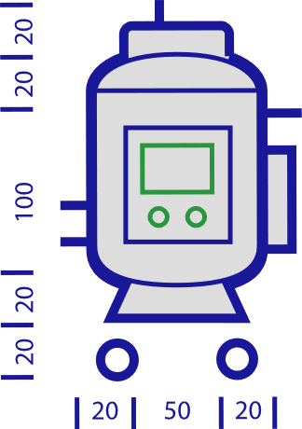
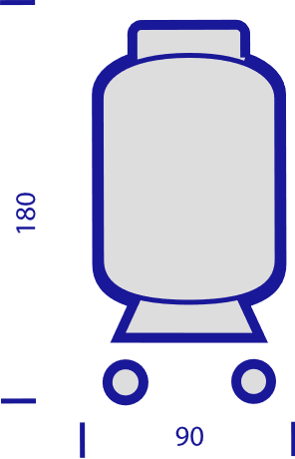
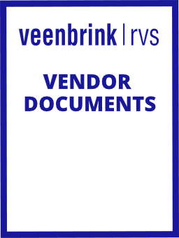
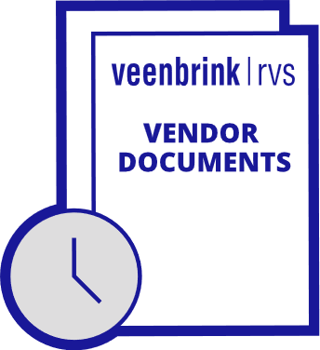
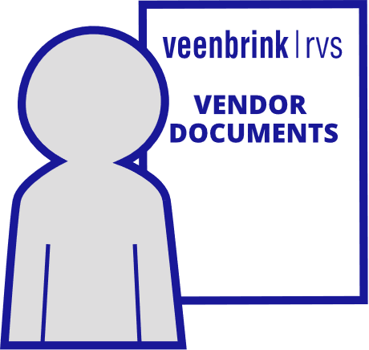
HOW WE DO IT
Tailor-made offer
Order intake
Engineering
Project Management
Testing
Production
Procurement
Quality assurance
Engineering
Production
Final inspection and delivery
Our mode of operation
Veenbrink RVS uses a project-based approach. This is a conscious choice: our project managers are involved throughout the entire project and therefore know all of the project’s ins and outs. This results in flexibility and the ability to quickly change gears when necessary.
19

Slide 20
WHO WE WORK FOR
Pharmaceutical
Within the pharmaceutical industry, Veenbrink RVS supplies process equipment for the preparation of aqueous, powdery and highly viscous media. The sterile preparation process must comply with strict criteria that require extensive knowledge of critical design guidelines such as GMP and GAMP. In addition to high finishing standards, validation documents and material traceability also play a major role.
Tank and machine builders
End users
Fitters
Consultants and engineers
20
Food & Beverage
Production processes are highly versatile in the food and beverage industry as well. Every product is unique and must be produced in its own particular way. Aside from a product’s specific properties, hygiene plays an essential role in equipment design and production. Veenbrink RVS is familiar with all applicable EHEDG and other directives in this regard.

Slide 21
WHO WE WORK FOR
Food & Beverage
Production processes are highly versatile in the food and beverage industry as well. Every product is unique and must be produced in its own particular way. Aside from a product’s specific properties, hygiene plays an essential role in equipment design and production. Veenbrink RVS is familiar with all applicable EHEDG and other directives in this regard.
Pharmaceutical
Within the pharmaceutical industry, Veenbrink RVS supplies process equipment for the preparation of aqueous, powdery and highly viscous media. The sterile preparation process must comply with strict criteria that require extensive knowledge of critical design guidelines such as GMP and GAMP. In addition to high finishing standards, validation documents and material traceability also play a major role.
Tank and machine builders
End users
Fitters
Consultants and engineers
21
Dairy
Within the dairy industry, Veenbrink RVS is familiar with the production of all typical dairy processing equipment. We design and produce this equipment for processing raw milk, butter, cheese, yoghurt and other dairy-related products. Aside from hygiene, efficiency also plays a major role in view of the dairy industry’s extensive product range.

Slide 22
WHO WE WORK FOR
Food & Beverage
Dairy
Production processes are highly versatile in the food and beverage industry as well. Every product is unique and must be produced in its own particular way. Aside from a product’s specific properties, hygiene plays an essential role in equipment design and production. Veenbrink RVS is familiar with all applicable EHEDG and other directives in this regard.
Within the dairy industry, Veenbrink RVS is familiar with the production of all typical dairy processing equipment. We design and produce this equipment for processing raw milk, butter, cheese, yoghurt and other dairy-related products. Aside from hygiene, efficiency also plays a major role in view of the dairy industry’s extensive product range.
Tank and machine builders
End users
Fitters
Consultants and engineers
22
Chemical
In the chemical sector everything revolves around a well-thought-out and above all safe design that meets all applicable laws and regulations. This is especially important because chemical processes often go hand in hand with high pressures and temperatures, which can result in dangerous situations. At Veenbrink RVS reliability and safety are always a priority in the design and production of pressure equipment.

Slide 23
WHO WE WORK FOR
Dairy
Chemical
Within the dairy industry, Veenbrink RVS is familiar with the production of all typical dairy processing equipment. We design and produce this equipment for processing raw milk, butter, cheese, yoghurt and other dairy-related products. Aside from hygiene, efficiency also plays a major role in view of the dairy industry’s extensive product range.
In the chemical sector everything revolves around a well-thought-out and above all safe design that meets all applicable laws and regulations. This is especially important because chemical processes often go hand in hand with high pressures and temperatures, which can result in dangerous situations. At Veenbrink RVS reliability and safety are always a priority in the design and production of pressure equipment.
Tank and machine builders
End users
Fitters
Consultants and engineers
23

Slide 24
QUALITY IS PRIORITY
Certified welding processes
Standards and guidelines
Weld map
WPS
PQR
WPQ
Weld log list
PED
NoBo
G(A)MP
Non-destructive testing
Visual Inspection
X-ray Inspection
Dye penetrant testing
Ferrite-content measurement
Positive material identification
Borescope inspection
Hydrostatic pressure test
CE Marking
24

Slide 25
SUCCESS STORIES
Mobile bioreactor units
Mobile vessels 600L
ATEX compliant vessels with TCU
ATEX compliant pharma vessels
Compact mobile CIP unit 100L
ATEX-compliant pharma vessels
Mobile pre-mixing product line + CIP
Mobile buffer vessels 250L
25
Notes:
Press the play button. When done, press Escape once and then the right arrow key.

Slide 26
OUR CUSTOMERS
26

Slide 27
QUALITY IS OUR PRIORITY
YOUR IDEAL PARTNER IN THE PROCESS INDUSTRY

